Slide 1
Claude Usage Analysis
Is Claude paying off?
Data Source: Illustrative data
Portfolio project · AI adoption analytics
An AI usage and value dashboard for a 60-person analytics team: from business question to data model to insight.
Business Analyst · Data Analyst · Data Engineer

Slide 2
The Problem
Every member holds a Claude license and the team uses Claude Code. But how do we know if this works for our team?
Data Source: Illustrative data
Adoption
How many of the licenses are used, and how deeply?
How can we define the usage of the AI tool, for different roles in the team?
Cost
What is the cost of the active users?
How much is spent on licenses nobody uses?
Effectiveness
Do we know if Claude's output is accepted as-is, or is frequently rejected and adds review overhead.

Slide 3
Business Context
Who uses the dashboard and what is in or out of scope
Data Source: Illustrative data
Role | What they want to see from the dashboard
Head of Analytics (sponsor) | Renewal and license decisions; overall adoption, cost and acceptance
Project manager | Adoption trend by team and role; Who needs help getting hands-on.
Team leads (BA, DA, DE) | Their team's engagement and acceptance rates; user-level detail
Finance partner | Monthly license and usage cost; idle-license cost
In scope
  The project covers Claude only, across three themes: adoption, cost and effectiveness.
  Claude usage across chat, Claude Code, Cowork and the Office add-ins
  License and usage cost per user
  Accept and reject decisions on Claude Code edit suggestions
  A dummy dataset shaped to match Claude's real API and telemetry fields is used
Out of scope
  Gemini, GitHub Copilot and any other AI tool
  Governance and unapproved-tool monitoring
  Task or ticket tracking (no Jira data)
  Survey feedback and satisfaction scores
  Prompt or response content of any kind
  Productivity or time-saved estimates

Slide 4
Custom Logics
What are the key measurement KPI and what do they mean.
Data Source: Illustrative data
 | Metric | Definition
Usage How are we measuring the adoption and engagement | Active User | A user with at least 5 active days in the month, where an active day has at least one interaction.
 | Adoption Rate | Active users ÷ licensed users in the month × 100.
 | Engagement Score | Each interaction activity (basic prompting , advanced agentic flow, etc.) is given a score, based on its complexity. Score for some activities like chat are capped for a daily usage so that no single activity can dominate a day's score. See BRD for more details.
 | Engagement benchmark | For each user role (Project manager, BA, DA, DE) a daily benchmark is assigned. Benchmark for each role is the median engagement score per active user-day over the three most recent complete months, recalculated at each quarterly refresh. See BRD for more details.
Cost How are we calculating the cost | Total cost | License cost + usage cost for the period
 | Idle - License cost | License cost of users who hold a license and had no activity in the last two months
Effectiveness How do we measure what AI content is actually useful | User decisions | Accept and reject decisions made by a person at a prompt, excluding automatic approvals
 | Acceptance rate | Accepted user decisions ÷ user decisions × 100
 | Explicit rejection rate | Decisions where the user chose "No" ÷ user decisions × 100. Proxy for error and correction frequency
 | Auto-approval share | Decisions approved by settings or hooks ÷ all decisions × 100. Shows how much output goes unreviewed

Slide 5
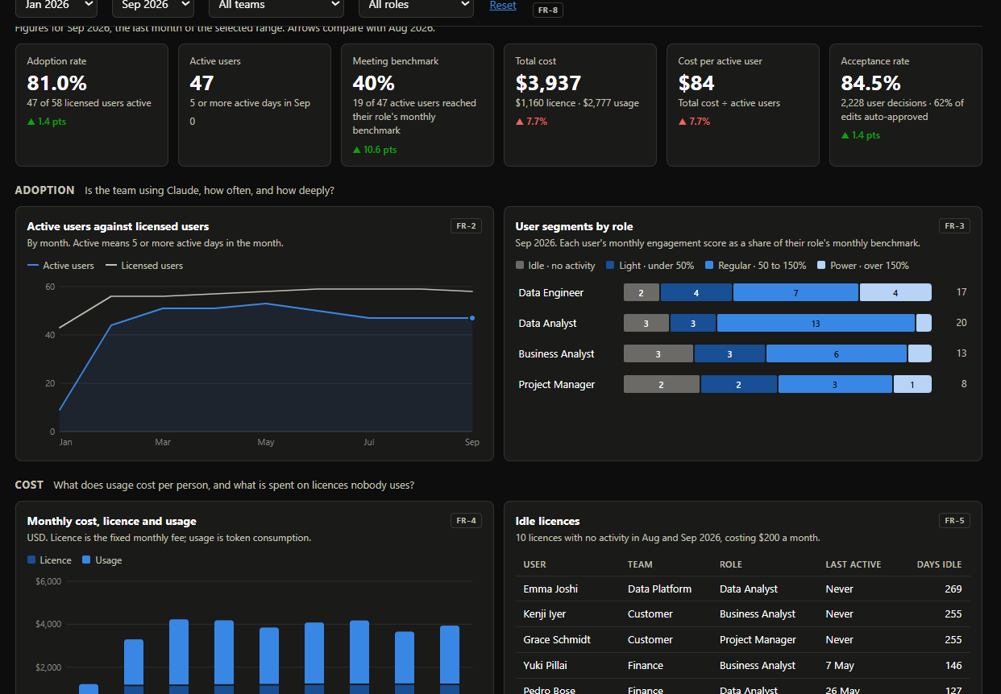
AI Usage Dashboard
Insights from the dashboard
Data Source: Illustrative data
Usage
81%
Of licenced users where active in September 2026
cost
70%
Of cost is from usage of the tool in September 2026. Only 10 idle users
Effectiveness
85%
Of user decisions (excluding the automatic approvals) are accepted. However 62% of the over all decisions are auto approved.
https://chinnuj.github.io/AI-usage-dashboard/

Slide 6
AI Usage Recommendation
Actionable recommendation for optimising AI usage
Data Source: Illustrative data
Set a review rule for auto-approved edits –
  Start with the project managers who build with Claude Code: 84% of their edits skip review.
Coach the Idle and Light users
  22 of 58 licensed users were Idle or Light in September.
Reassign or drop the 10 idle licenses –
  A small saving, but each has had no activity for two months or more.

